Slide 1
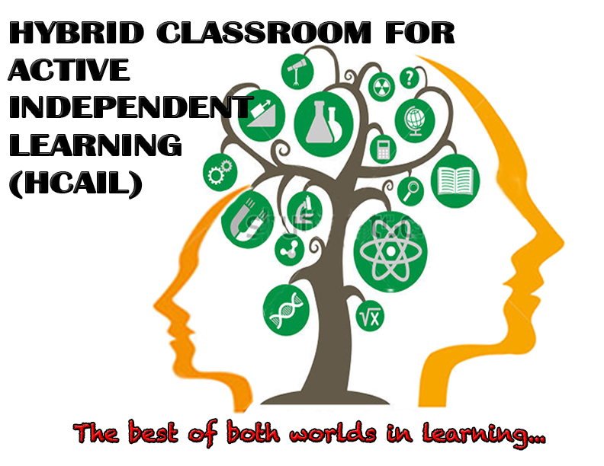
Benefits and Challenges
1. ELSIE SHARON GILUK
2. JENNIFER R. JOVITA
3. KEVIN MFILINGE
4. MARISOL ANDRADA
5. MOLLYDEAN BUNTUYA
of a Hybrid Classroom

Slide 2
BENEFITS
Students can work online anytime of the day or night.
It enhances greater retention of course content.
Learners are able to take responsibility for the learning process
It gives opportunity to students who might be shy or feel intimidated in a face-to-face classroom to thrive online.

Slide 3
It is student-centered and therefore increases in depth understanding.
There is deeper level of engagement with teaching learning materials.
Technological skills are learned for future education, work and life.

Slide 4
It gives options in teaching. Better online pedagogical and technological skills are used while retaining the valued face-to-face interaction with students.
It addresses different learning styles.
There is time to examine student’s work more thoroughly.

Slide 5
CHALLENGES
It needs internet service to work well.
It needs availability and knowledge in technological skills.
It is not easy to set a hybrid classroom.

Slide 6
It is demanding on the instructor as he has the duty of preparing students to play an active role, assist students in keeping work on time and on track.
There is the need for the instructor to learn how to facilitate online discussion and reexamine traditional assessment of students’ work.

Slide 7
THANK YOU!

